Slide 1
WEEK 17
CESAR A. PASCAL VASQUEZ

Slide 2
This week, I focused on extending the Unitree R1 work from basic locomotion toward manipulation tasks. The main goal was to create training environments where the R1 could use its right arm to reach, grasp, and perform a door-opening motion in MuJoCo.

Slide 3
Repository and model setup
The first step was to make sure the correct R1 MuJoCo model was being used. The local repository was found under the Embodie AI Reports folder, and the scripts were updated to handle paths with spaces correctly.
Locate
repository
Find
r1.xml
Patch invalid
XML exclusions
Inspect
R1 arm
The inspection confirmed 24 generalized coordinates, 24 actuators, and the five right-arm joints needed for the manipulation policy.

Slide 4
R1 right-arm reaching task
A fixed-base reaching environment was created first. In this task, the robot body remains stable while PPO controls the right shoulder, elbow, and wrist-roll joints to move the palm toward a red target.
right_palm → target
R1 shoulder
elbow / wrist
right_palm
target
This reaching stage was useful because it isolated arm control before adding grasping, object contact, or door interaction.

Slide 5
Validation of the reaching environment
The inspection and smoke test both passed. The smoke test used random actions, so the final distance was not expected to be small; its purpose was only to verify that the model, actuators, observations, and rewards were stable.
Removing invalid contact exclusion: body1='left_elbow_link', body2='left_wrist_pitch_link'
Removing invalid contact exclusion: body1='right_elbow_link', body2='right_wrist_pitch_link'
Smoke test passed. Final palm-to-target distance: 0.1911 m
This confirmed that the arm-reaching environment was ready for PPO training.

Slide 6
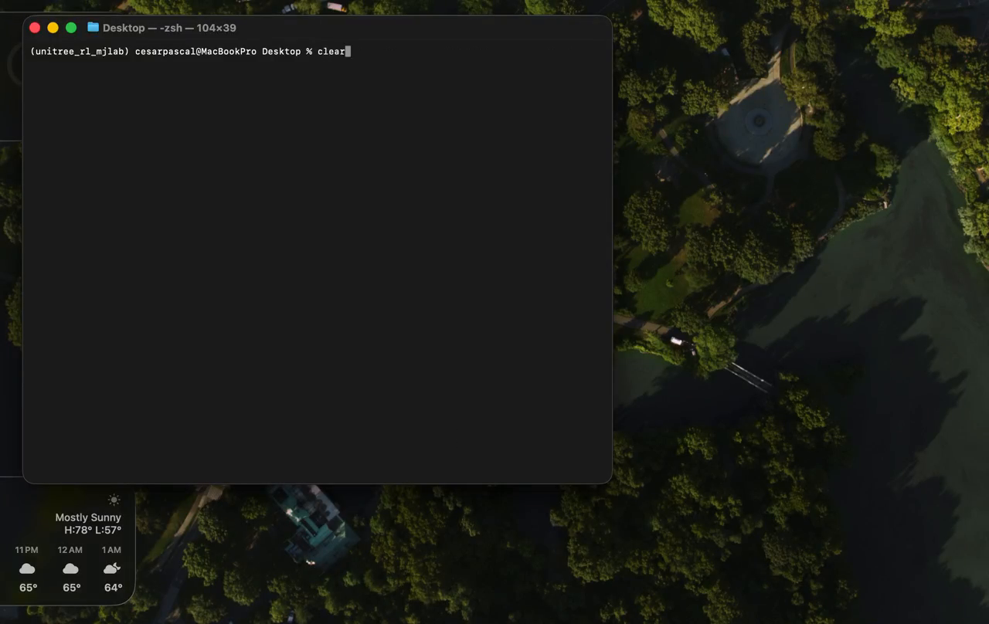
Untrained door policy visualization
Before training, the policy did not understand the door task. The arm motion was mostly random, so the gripper did not consistently approach or pull the handle.
Untrained policy: random actions before learning the door-opening reward.

Slide 7
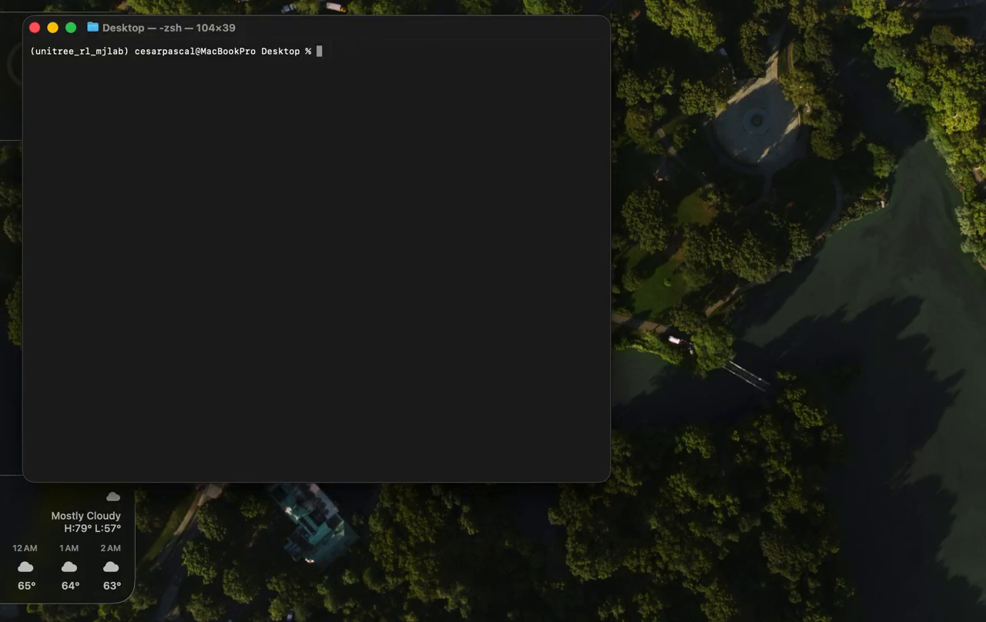
Intermediate trained policy visualization
After training on the easier door task, the policy began to produce more organized arm motion. The gripper started moving toward the handle and showed the early structure of the opening behavior.
Intermediate policy: arm motion became more directed after the first training stage.

Slide 8
Training curriculum
The door task was trained in stages. The easier version used a closer handle and a smaller success angle. After that policy finished, it was resumed with a farther handle and a larger required opening angle.
Stage 1
3,000,000 steps
0.12 m handle
Resume policy
from final .zip
previous run
Stage 2
2,000,000 steps
0.14 m handle
The success angle increased from 0.45 rad to 0.65 rad, which means the harder task required the door to open more.

Slide 9
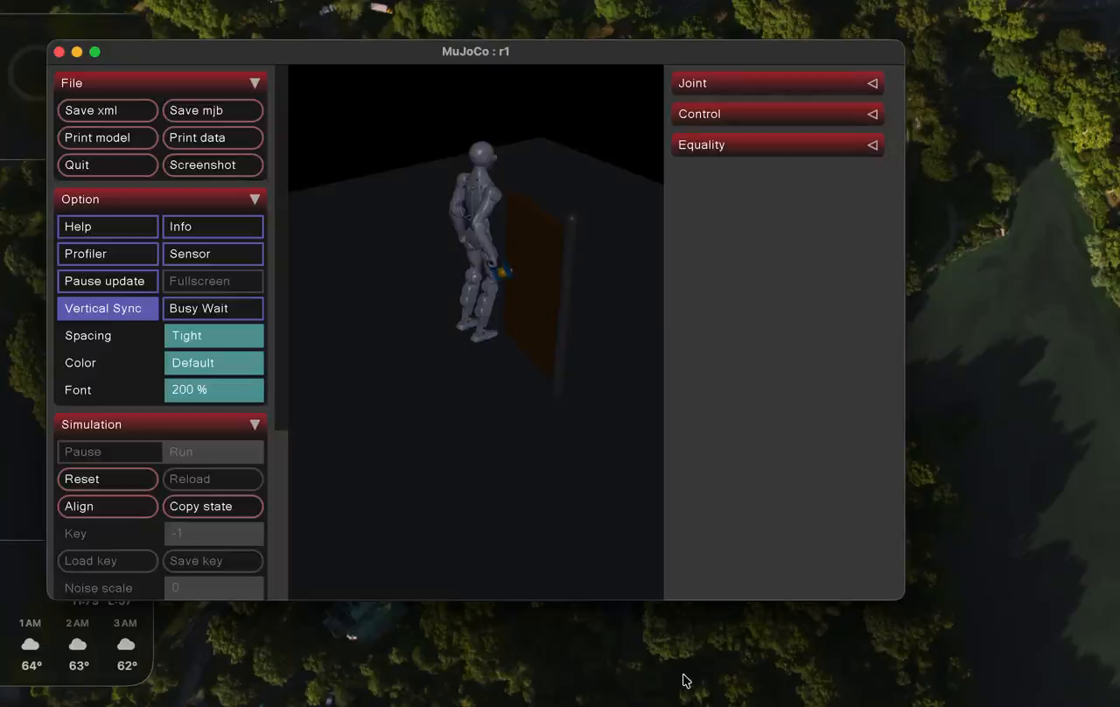
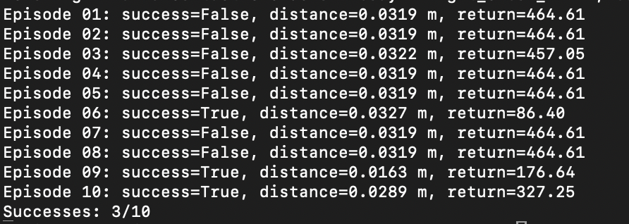
Final trained policy visualization and evaluation
The harder training stage completed successfully and the final policy was visualized. In the first evaluation run, the policy reached a 3/10 success rate while keeping the final hand distance close to the handle.
First 10-episode evaluation: 3 successful episodes out of 10.
Final policy visualization
The result shows clear progress, but more training and reward tuning are still needed for consistent door opening.

Slide 10
Next steps
The next steps are to visualize the harder policy, record successful and failed episodes, and adjust the reward if the robot reaches the handle but does not consistently pull the door open. Once the arm behavior is stable, the task can be combined with standing or walking control.
visualize
trained policy
measure
success rate
tune reward
and curriculum
combine
with gait
A GPU or multiple parallel environments would likely improve training speed and stability for future manipulation policies.

Slide 11
Reference
Todorov, E., Erez, T., & Tassa, Y. (2012). MuJoCo: A physics engine for model-based control. IEEE/RSJ International Conference on Intelligent Robots and Systems (IROS), 5026–5033.
Unitree Robotics. Unitree RL Mjlab: Reinforcement learning project built on mjlab with MuJoCo physics simulation backend. Retrieved from https://github.com/unitreerobotics/unitree_rl_mjlab

